Slide 1
Christian Volunteer Services (CVS) Analysis Report
https://youtu.be/uj9Mk7qZUfY
Notes:
Hello board members of Christian Volunteer Services, our firm was hired to complete an in depth analysis of your existing IT infrastructure and to review the plans laid out for your proposed solution. I am Idil and I am going to be your presenter for the day.

Slide 2
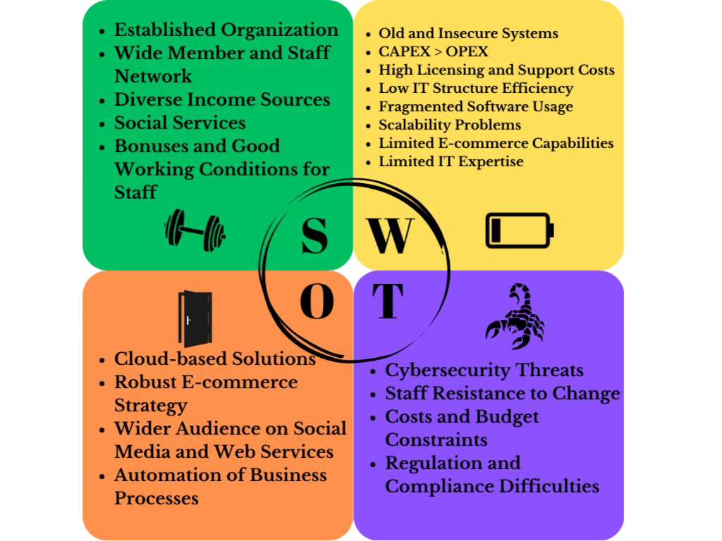
SWOT Analysis of existing System
Notes:
Strengths
CVS has a long history and is well-established, providing stability and trust. They have a large network of members and employees, which can aid in broadening support and resources. They have diverse income sources, including donations, legacy income, and sales from charity shops. They have strong focus on social services, contributing positively to the community. They provide Competitive pay, bonuses, and good working conditions that help retain staff.
Weaknesses
The reliance on outdated and insecure systems increases risks of data breaches and inefficiencies. Higher capital expenditures compared to operational expenditures, leading to increased financial strain. Significant expenses associated with software licensing and support. Frequent system downtimes and slow performance hinder productivity. Disparate software solutions used across the organization, leading to management challenges and inefficiencies. : A need for more skilled IT personnel to manage and innovate within the existing infrastructure.
Opportunities
Adopting cloud technologies can modernize the IT infrastructure and improve scalability and flexibility. Implementing a robust e-commerce platform to enhance sales from donated items. Leveraging social media and web services to increase engagement and donations. Using automation to streamline operations and reduce manual workload.
Threats
Increased risk of cyber attacks due to outdated systems and fragmented security measures. Potential resistance from staff regarding the adoption of new technologies and processes. Financial limitations may restrict the ability to invest in new technologies. Challenges in meeting regulatory and compliance requirements due to outdated systems and processes.

Slide 3
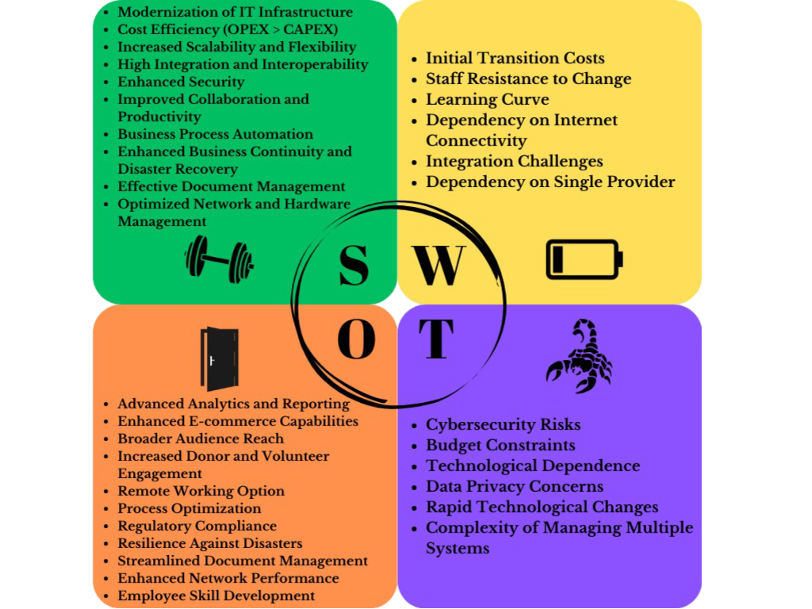
SWOT Analysis of proposed System
Notes:
Strengths
Transitioning to cloud-based solutions like Azure Virtual Machines and Kubernetes services updates CVS's outdated systems, enhancing overall IT efficiency and reliability. The 3-year cost of £1.5 million for the entire infrastructure represents a manageable operational expense, allowing for better financial planning and management. Cloud-based solutions and containerization with SQL Server Containers offer scalable resources that adjust based on demand, providing flexibility for future growth. Using Microsoft Dynamics 365 suite and other integrated tools ensures seamless data flow and operational efficiency across CRM, HRM, finance, and more. Advanced security measures and tools like Microsoft Defender for Endpoint, Azure Active Directory, and Azure Security Center improve data protection and compliance. Tools like Microsoft 365 Office, Teams, and SharePoint facilitate better communication, collaboration, and productivity among staff. Automating business processes with cloud solutions and container orchestration (Kubernetes) reduces manual workload and errors. Implementing robust business continuity and disaster recovery solutions ensures minimal disruption and quick recovery from potential disasters. Using a document management system like Microsoft SharePoint improves document organization, access, and collaboration. Advanced tools for network and hardware management enhance infrastructure reliability and performance.
Weaknesses
While long-term costs may decrease, initial transition expenses, including training and system migration, could be significant. Employees accustomed to legacy systems may resist the transition to new technologies, impacting adoption rates. Implementing new technologies such as AKS and SQL Server containers requires staff training, which might temporarily reduce productivity. Cloud-based operations rely heavily on stable internet connections; any disruptions could affect accessibility and productivity. Integrating existing legacy systems with new cloud-based solutions may present technical challenges and require additional resources.
Opportunities
Utilizing Microsoft Power BI for analytics and reporting can provide deeper insights into operations, aiding strategic decision-making. Implementing Shopify Plus can expand CVS's e-commerce presence, increasing online sales and donations. Leveraging social media management tools like Hootsuite can help CVS reach a wider audience and improve engagement. Modern CRM and communication tools can enhance relationships with donors and volunteers, leading to increased support. Automation of routine tasks can streamline operations, reduce errors, and free up staff for higher-value activities. Modern systems can help ensure compliance with data protection regulations, reducing the risk of legal issues. Enhanced disaster recovery plans ensure continuity of operations and protect against data loss. Improved document management processes enhance efficiency and reduce risks associated with document handling. Optimized network management improves overall performance and reduces downtime. Providing training for new technologies will make employees more skilled and adaptable, improving overall organizational performance.
Threats
Despite advanced security measures, the shift to cloud-based systems can expose CVS to new cybersecurity threats. Ongoing operational expenses and unexpected costs associated with cloud services might strain the budget. Heavy reliance on specific technology providers (e.g., Microsoft) could pose risks if there are changes in service terms or disruptions. Handling sensitive data in the cloud requires stringent compliance with privacy regulations, which can be challenging to manage. Keeping up with the fast pace of technological advancements requires continuous learning and adaptation. Adding new systems increases the complexity of IT management and requires additional resources for effective administration.
I should also state that Microsoft offers many educational services for free, and taking care of the resistance to change from staff can be provided with some incentives that go hand in hand with these learning platforms. Personel can be incentivised with a raise if they complete certain points in their education.

Slide 4
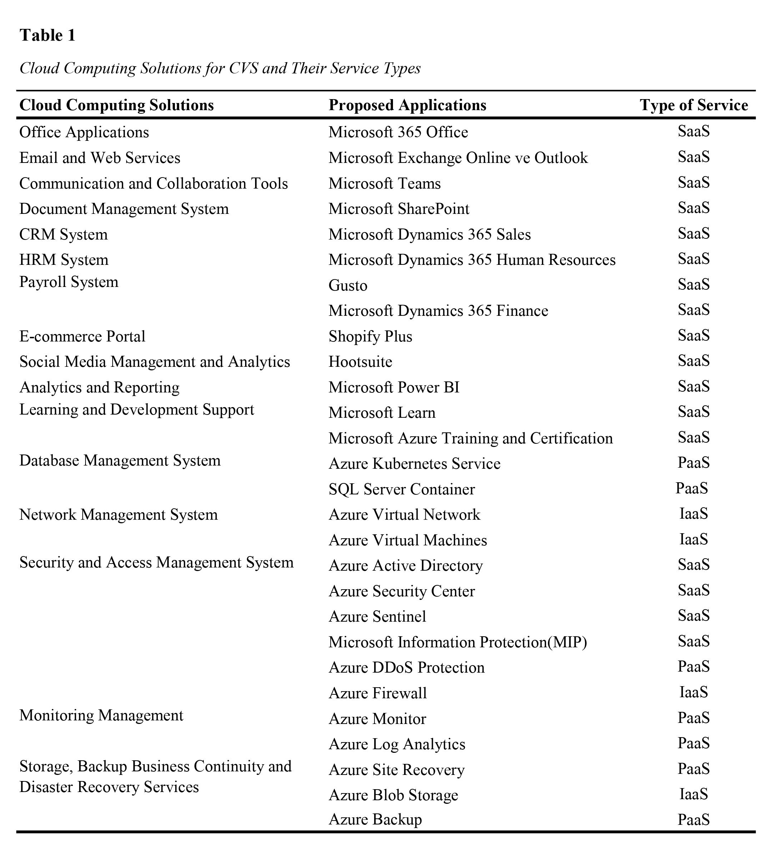
SaaS, PaaS & IaaS service provision analysis
Notes:
Software as a Service applications are subscription-based, they reduce the need for physical hardware, and ensure that the software is always up-to-date. Platform as a Service applications provides a platform for developing, running, and managing applications without the complexity of infrastructure maintenance. And Infrastructure as a Service applications provide virtualized computing resources over the internet, offering flexibility and scalability.

Slide 5




Recommended commercial service provider
Notes:
Microsoft’s Role is central to the proposed solution due to its comprehensive suite of cloud services. All IaaS, PaaS, and SaaS services have seamless integration with each other, and this is going to enhance the business processes. Microsoft has some robust security measures and CVS will also benefit from all of them, and having both security and other applications at the same service provider offers tailor-suited security features. The pricing of the services is competitive, but it is possible to find the best fit for the company’s needs through extensive research.
Some services are provided outside of Microsoft's scope. For example, Shopify will be utilized to enhance e-commerce capabilities, allowing CVS to expand its online sales and donation channels effectively. Hootsuite will manage social media presence, increasing engagement and outreach. Gusto will handle payroll and HR functions, ensuring that these critical administrative tasks are managed efficiently and in compliance with regulations. This combination of Microsoft services and third-party tools that are fully integrated micorosft services ensures a comprehensive, integrated solution tailored to CVS's specific needs, promoting operational efficiency and strategic growth.

Slide 6


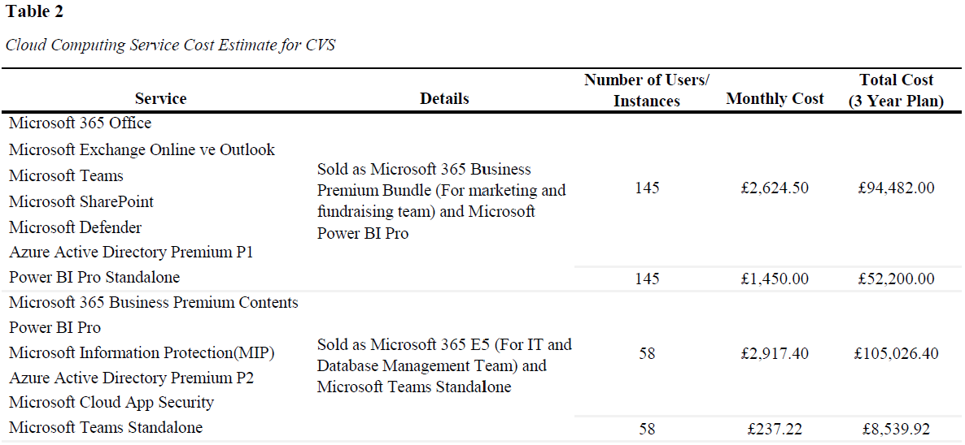
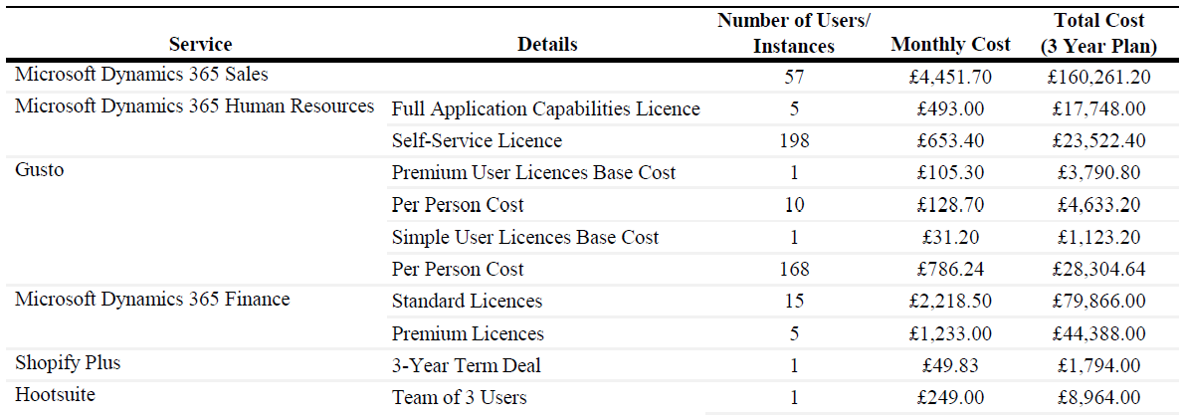
Cost analysis
Notes:
As I just mentioned it is possible to find the best fit for the company’s needs through extensive research by looking through all different options they offer. For example look at the image on the left corner, what youre seeing are two different Microsoft 365 service deals, one referred to as business premium, the other is E5. Both options include basic applications like Office 365, Teams, SharePoint, and Exchange Online. Business Premium is targeted at the marketing and fundraising teams, whereas E5 is designed for the IT and database management team. The choice between these depends on the specific needs of each team, balancing cost with functionality.
Microsoft Dynamics 365 covers CRM, HRM, and finance solutions, providing an integrated approach to managing customer relationships, human resources, and financial operations. For payroll, we are proposing Gusto, which offers scalable payroll and benefits management. Shopify Plus will enhance the e-commerce capabilities, integrating seamlessly with the other systems.

Slide 7
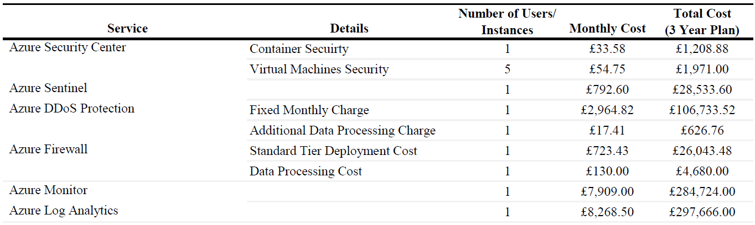
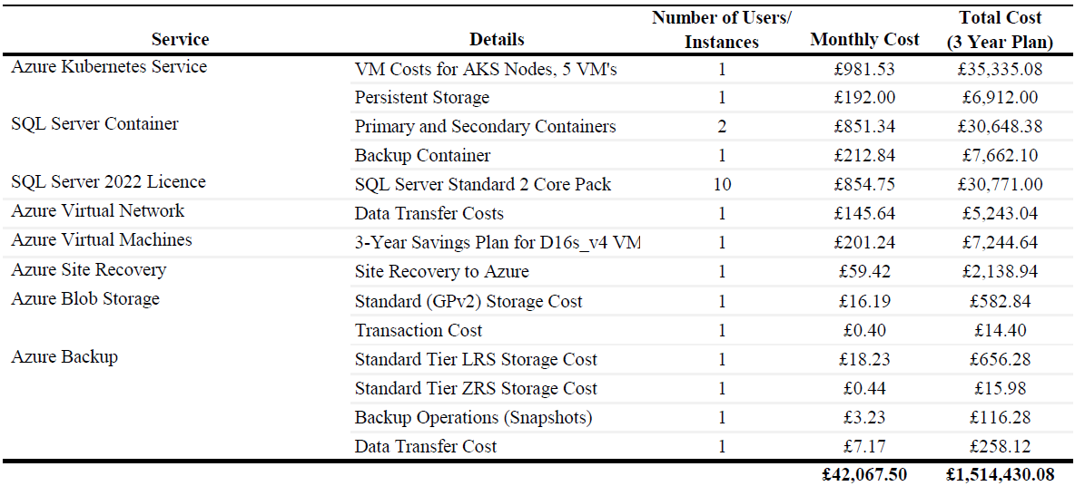
Note: All calculations are based on the following assumptions:
(1) Currency: 1 USD = 0.78 GBP (2) Company Structure: approximately 200 users (IT and Programmer/Database Support Personnel: 58 users, Marketing and Fundraising: 120 users, HR: 15 users, Management: 10 users (3) System Requirements and Specifications: CPU: 8-16 vCPU, RAM: 32-64 GB RAM, Storage: 1 TB SSD, Network Bandwidth: High. Virtual Machines: D16s_v4 (16 vCPU, 64 GB RAM), Number of VMs: 5. SQL Server Containers (Primary and Secondary Containers: 8 vCPU, 32 GB RAM; Backup Containers: 4 vCPU, 16 GB RAM), Azure Virtual Machines: VM Instance: D16s_v4 (16 vCPU, 64 GB RAM)
Cost analysis
Notes:
Azure Kubernetes Services for container orchestration will be utilized, ensuring the applications are scalable and manageable. SQL Server Containers will handle the primary and secondary database operations, supported by SQL Server 2022 licenses. Azure Virtual Network and Azure Virtual Machines provide the necessary infrastructure to support your operations securely.
Security is a top priority in our approach. Azure Security Center, Azure Sentinel, and Microsoft Information Protection systems are being utilized to safeguard the data. Azure DDoS Protection and Azure Firewall are products that are being used to protect systems against cyber threats. And azure Monitor and Azure Log Analytics will help with maintaining operational oversight and quickly address any issues that arise.
With a total estimated 3-year cost of approximately £1,514,430.08, this investment will provide significant long-term benefits and position CVS for future growth.
Note that all calculations are based on the following assumptions: (1) Currency: 1 USD = 0.78 GBP (2) Company Structure: approximately 200 users (IT and Programmer/Database Support Personnel: 58 users, Marketing and Fundraising: 120 users, HR: 15 users, Management: 10 users (3) System Requirements and Specifications: CPU: 8-16 vCPU, RAM: 32-64 GB RAM, Storage: 1 TB SSD, Network Bandwidth: High. Virtual Machines: D16s_v4 (16 vCPU, 64 GB RAM), Number of VMs: 5. SQL Server Containers (Primary and Secondary Containers: 8 vCPU, 32 GB RAM; Backup Containers: 4 vCPU, 16 GB RAM), Azure Virtual Machines: VM Instance: D16s_v4 (16 vCPU, 64 GB RAM)

Slide 8






INaaS & BPaaS services & development analysis
Notes:
This proposal already has some applications that enhance business processes up to some point. But Information as a Service (INaaS) and Business Process as a Service (BPaaS) will be crucial in the coming years. Recommendations include leveraging Microsoft Power BI Embedded for advanced analytics, Microsoft Dynamics 365 for business process management, and Azure Machine Learning for predictive analytics including some other possible options that are explained in depth in the report. These services will enhance the decision-making capabilities, streamline business processes, and improve overall efficiency.

Slide 9

Initiatives to minimize environmental impact.
Innovative solutions like underwater data centers.
Goals to be carbon negative by 2030 and offset all historical emissions by 2050.
Investments in renewable energy and reduction strategies.
Discussion on the challenges of complete environmental friendliness.
Importance of continuous improvement and industry leadership.
Sustainability Discussion
?
Notes:
Microsoft is deeply committed to sustainability, actively engaging in various initiatives to reduce their carbon footprint. One notable example is their development of underwater data centers, designed to increase energy efficiency and lower cooling costs compared to traditional data centers. While these innovative solutions are impressive, they are not without ecological concerns. For instance, the effects of underwater data centers on marine ecosystems are not fully understood and raise some concerns. Microsoft has set ambitious sustainability goals: to become carbon negative by 2030 and to offset all historical carbon emissions by 2050. To achieve these goals, they invest heavily in renewable energy sources and implement strategies to reduce carbon emissions across their supply chain. But I personally believe that it is currently impossible for any company, especially large-scale technology firms, to be entirely environmentally friendly. The production and operation of technology inevitably leave an environmental footprint. However, Microsoft has made significant strides in sustainability and puts serious effort into fulfilling its environmental responsibilities. Although achieving the complete elimination of environmental impacts is challenging, the company's determination and continuous improvement efforts place it in a favorable position regarding sustainability. In conclusion, while it is not possible to eliminate environmental impacts entirely, increasing and improving sustainability efforts, like those by Microsoft, will contribute significantly to a more sustainable future. These initiatives are critically important for both the environment and Microsoft’s reputation.

Slide 10
References
Gusto. (n.d.). Pricing. Retrieved July 20, 2024, from https://gusto.com/product/pricing
Hootsuite. (n.d.). Plans. Retrieved July 20, 2024, from https://www.hootsuite.com/plans
Microsoft. (n.d.). Azure Active Directory pricing. Retrieved July 20, 2024, from https://azure.microsoft.com/en-us/pricing/details/active-directory-b2c/
Microsoft. (n.d.). Azure Backup pricing. Retrieved July 20, 2024, from https://azure.microsoft.com/en-gb/pricing/details/backup/#pricing
Microsoft. (n.d.). Azure Blob Storage pricing. Retrieved July 20, 2024, from https://azure.microsoft.com/en-us/pricing/details/storage/blobs/#pricing
Microsoft. (n.d.). Azure DDoS Protection pricing. Retrieved July 20, 2024, from https://azure.microsoft.com/en-us/pricing/details/ddos-protection/#pricing
Microsoft. (n.d.). Azure Firewall pricing. Retrieved July 20, 2024, from https://azure.microsoft.com/en-us/pricing/details/azure-firewall/
Microsoft. (n.d.). Azure Kubernetes Service pricing. Retrieved July 20, 2024, from https://azure.microsoft.com/en-gb/pricing/details/kubernetes-service/#pricing
Microsoft. (n.d.). Azure Monitor pricing. Retrieved July 20, 2024, from https://azure.microsoft.com/en-gb/pricing/details/monitor/
Microsoft. (n.d.). Azure Pricing Calculator. Retrieved July 20, 2024, from https://azure.microsoft.com/en-gb/pricing/calculator/?&ef_id=_k_Cj0KCQjwtZK1BhDuARIsAAy2VztGJUAAyUQlaVsKNn-T6tVy-Zb3Uof_s-Wo0izDZFtNhyUFjutixjMaApZ9EALw_wcB_k_&OCID=AIDcmm3bvqzxp1_SEM__k_Cj0KCQjwtZK1BhDuARIsAAy2VztGJUAAyUQlaVsKNn-T6tVy-Zb3Uof_s-Wo0izDZFtNhyUFjutixjMaApZ9EALw_wcB
Microsoft. (n.d.). Azure Site Recovery pricing. Retrieved July 20, 2024, from https://azure.microsoft.com/en-gb/pricing/details/site-recovery/#pricing
Microsoft. (n.d.). Compare all Microsoft 365 Business products. Retrieved July 20, 2024, from https://www.microsoft.com/en-gb/microsoft-365/business/compare-all-microsoft-365-business-products
Microsoft. (n.d.). Dynamics 365 Finance pricing. Retrieved July 20, 2024, from https://www.microsoft.com/en-gb/dynamics-365/products/finance/pricing
Microsoft. (n.d.). Dynamics 365 Human Resources pricing. Retrieved July 20, 2024, from https://www.microsoft.com/en-gb/dynamics-365/products/human-resources#Pricing
Microsoft. (n.d.). Dynamics 365 Sales pricing. Retrieved July 20, 2024, from https://www.microsoft.com/en-gb/dynamics-365/products/sales#Pricing
Microsoft. (n.d.). Learn. Retrieved July 20, 2024, from https://learn.microsoft.com/en-gb/
Microsoft. (n.d.). Microsoft 365 E5 pricing. Retrieved July 20, 2024, from https://www.microsoft.com/en-gb/microsoft-365/enterprise/e5?activetab=pivot:overviewtab
Microsoft. (n.d.). Microsoft 365 Licensing. Retrieved July 20, 2024, from https://www.microsoft.com/en-gb/licensing/news/Microsoft365-Teams-WW?SilentAuth=1&f=255&MSPPError=-2147217396
Microsoft. (2020, January 16). Microsoft will be carbon negative by 2030. Microsoft Official Blog. Retrieved July 20, 2024, from https://blogs.microsoft.com/blog/2020/01/16/microsoft-will-be-carbon-negative-by-2030/
Microsoft. (n.d.). Microsoft Sentinel pricing. Retrieved July 20, 2024, from https://azure.microsoft.com/en-us/pricing/details/microsoft-sentinel/#pricing
Microsoft. (n.d.). Power BI pricing. Retrieved July 20, 2024, from https://www.microsoft.com/en-gb/power-platform/products/power-bi/pricing
Microsoft. (n.d.). SQL Server pricing. Retrieved July 20, 2024, from https://www.microsoft.com/en-us/sql-server/sql-server-2022-pricing
Microsoft. (n.d.). Sustainability. Retrieved July 20, 2024, from https://www.microsoft.com/en-us/sustainability/emissions-impact-dashboard
Microsoft. (n.d.). Virtual Machines pricing. Retrieved July 20, 2024, from https://azure.microsoft.com/en-us/pricing/details/virtual-machines/linux/
Shopify. (n.d.). Shopify Plus pricing. Retrieved July 20, 2024, from https://www.shopify.com/uk/plus/pricing?_bt=698332630287&_bk=shopify%20plus%20pricing&_bm=e&_bn=g&_bg=161528834349&utm_medium=cpc&utm_source=google&utm_term=shopify%20plus%20pricing&utm_campaign=Brand+%7C+EMEA+%7C+UKIE+%7C+UKIE+%7C+EN+%7C+Brand+Exact+%7C+Lead+Gen+%7C+Search&gad_source=1&gclid=Cj0KCQjw-5y1BhC-ARIsAAM_oKmXPji-E2jK5F8BFJHNFfq3-kevb8hFTT4U1wpSkwF4KaKuEIxn544aAjPZEALw_wcB&gclsrc=aw.ds
Notes:
Thank you for listening.

